Slide 1
Chapter 18
Testing Conventional Applications
Slide Set to accompany
Software Engineering: A Practitioner’s Approach, 7/e
by Roger S. Pressman
Slides copyright © 1996, 2001, 2005, 2009 by Roger S. Pressman
For non-profit educational use only
May be reproduced ONLY for student use at the university level when used in conjunction with Software Engineering: A Practitioner's Approach, 7/e. Any other reproduction or use is prohibited without the express written permission of the author.
All copyright information MUST appear if these slides are posted on a website for student use.
These slides are designed to accompany Software Engineering: A Practitioner’s Approach, 7/e (McGraw-Hill 2009). Slides copyright 2009 by Roger Pressman.

Slide 2
Software Testing Fundamentals
The goal of testing is to find errors, and a good test is one that has a high probability of finding an error. Therefore, you should design and implement a computer based system or a product with “testability” in mind.
These slides are designed to accompany Software Engineering: A Practitioner’s Approach, 7/e (McGraw-Hill 2009). Slides copyright 2009 by Roger Pressman.

Slide 3
Testability
“Software testability is simply how easily [a computer program] can be tested.” The following characteristics lead to testable software.
Operability—it operates cleanly
Observability—the results of each test case are readily observed
Controllability—the degree to which testing can be automated and optimized
Decomposability—testing can be targeted
Simplicity—reduce complex architecture and logic to simplify tests
Stability—few changes are requested during testing
Understandability—of the design
These slides are designed to accompany Software Engineering: A Practitioner’s Approach, 7/e (McGraw-Hill 2009). Slides copyright 2009 by Roger Pressman.

Slide 4
What is a “Good” Test?
Test Characteristics
  A good test has a high probability of finding an error.
  A good test is not redundant.
  A good test should be “best of breed”.
  A good test should be neither too simple nor too complex.
These slides are designed to accompany Software Engineering: A Practitioner’s Approach, 7/e (McGraw-Hill 2009). Slides copyright 2009 by Roger Pressman.

Slide 5
Internal and External Views
Any engineered product (and most other things) can be tested in one of two ways:
  Knowing the specified function that a product has been designed to perform, tests can be conducted that demonstrate each function is fully operational while at the same time searching for errors in each function;
  Knowing the internal workings of a product, tests can be conducted to ensure that "all gears mesh," that is, internal operations are performed according to specifications and all internal components have been adequately exercised.
These slides are designed to accompany Software Engineering: A Practitioner’s Approach, 7/e (McGraw-Hill 2009). Slides copyright 2009 by Roger Pressman.

Slide 6
Test Case Design
"Bugs lurk in corners
and congregate at
boundaries ..."
Boris Beizer
OBJECTIVE
to cover errors
CRITERIA
in a complete manner
CONSTRAINT
with a minimum of effort and time
These slides are designed to accompany Software Engineering: A Practitioner’s Approach, 7/e (McGraw-Hill 2009). Slides copyright 2009 by Roger Pressman.

Slide 7
Software Testing
white-box
methods
black-box
methods
Methods
Strategies
These slides are designed to accompany Software Engineering: A Practitioner’s Approach, 7/e (McGraw-Hill 2009). Slides copyright 2009 by Roger Pressman.

Slide 8

White-Box Testing
(Also called Glass-Box Testing)
... our goal is to ensure that all
statements and conditions have
been executed at least once ...
These slides are designed to accompany Software Engineering: A Practitioner’s Approach, 7/e (McGraw-Hill 2009). Slides copyright 2009 by Roger Pressman.

Slide 9
White-Box Testing
Using white-box testing methods, you can derive test cases that
(1) guarantee that all independent paths within a module have been exercised at least once,
(2) exercise all logical decisions on their true and false sides,
(3) execute all loops at their boundaries and within their operational bounds, and
(4) exercise internal data structures to ensure their validity
These slides are designed to accompany Software Engineering: A Practitioner’s Approach, 7/e (McGraw-Hill 2009). Slides copyright 2009 by Roger Pressman.

Slide 10
Why Cover?
logic errors and incorrect assumptions
are inversely proportional to a path's
execution probability
we often
believe
that a path is not
likely to be executed; in fact, reality is
often counter intuitive
typographical errors are random; it's
likely that untested paths will contain
some
These slides are designed to accompany Software Engineering: A Practitioner’s Approach, 7/e (McGraw-Hill 2009). Slides copyright 2009 by Roger Pressman.

Slide 11
Basis Path Testing
Basis path testing is a white-box testing technique first proposed by Tom McCabe.
The basis path method enables the test-case designer to derive a logical complexity measure of a procedural design and use this measure as a guide for defining a basis set of execution paths.
Test cases derived to exercise the basis set are guaranteed to execute every statement in the program at least one time during testing.
These slides are designed to accompany Software Engineering: A Practitioner’s Approach, 7/e (McGraw-Hill 2009). Slides copyright 2009 by Roger Pressman.

Slide 12
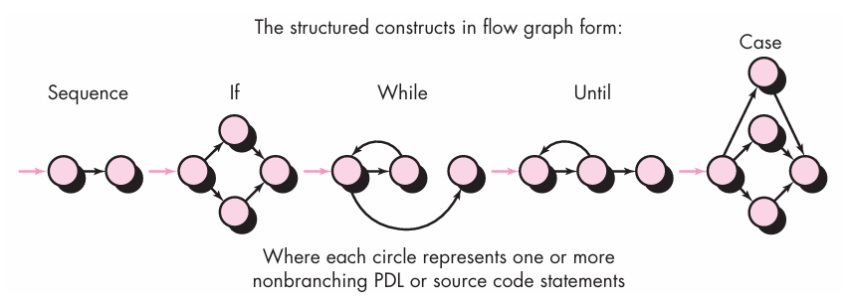
Basis Path Testing
Flow Graph Notation
A flow graph (or program graph) - a simple notation for the representation of control flow.
These slides are designed to accompany Software Engineering: A Practitioner’s Approach, 7/e (McGraw-Hill 2009). Slides copyright 2009 by Roger Pressman.

Slide 13


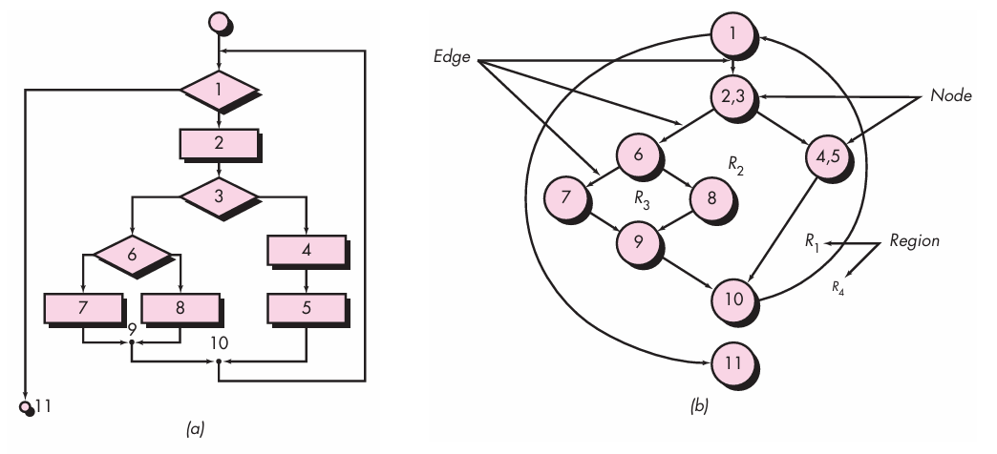
Basis Path Testing
Flow Graph Notation
These slides are designed to accompany Software Engineering: A Practitioner’s Approach, 7/e (McGraw-Hill 2009). Slides copyright 2009 by Roger Pressman.
Notes:
Figure a - flowchart is used to depict program control structure. Figure b maps the flowchart into a corresponding flow graph (assuming that no compound conditions are contained in the decision diamonds of the flowchart). Referring to Figure b, each circle, called a flow graph node, represents one or more procedural statements. A sequence of process boxes and a decision diamond can map into a single node. The arrows on the flow graph, called edges or links, represent flow of control and are analogous to flowchart arrows. An edge must terminate at a node, even if the node does not represent any procedural statements (e.g., see the flow graph symbol for the if-then-else construct). Areas bounded by edges and nodes are called regions. When counting regions, we include the area outside the graph as a region.

Slide 14
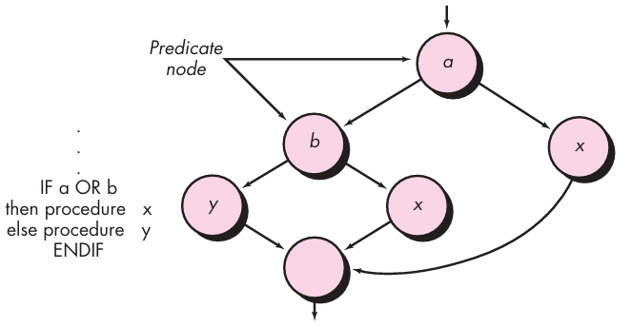
Basis Path Testing
Flow Graph Notation
Compound Logic
Each node that contains a condition is called a predicate node.
These slides are designed to accompany Software Engineering: A Practitioner’s Approach, 7/e (McGraw-Hill 2009). Slides copyright 2009 by Roger Pressman.

Slide 15
Independent Program Paths
An independent path is any path through the program that introduces at least one new set of processing statements or a new condition.
When stated in terms of a flow graph, an independent path must move along at least one edge that has not been traversed before the path is defined.
These slides are designed to accompany Software Engineering: A Practitioner’s Approach, 7/e (McGraw-Hill 2009). Slides copyright 2009 by Roger Pressman.

Slide 16
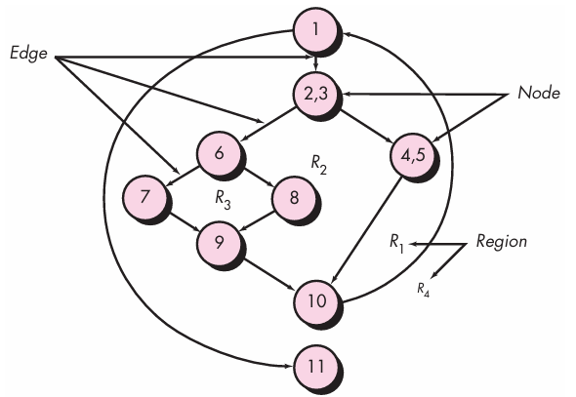
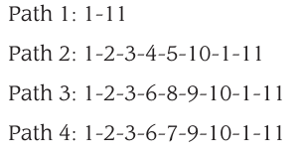

Independent Program Paths
These slides are designed to accompany Software Engineering: A Practitioner’s Approach, 7/e (McGraw-Hill 2009). Slides copyright 2009 by Roger Pressman.

Slide 17
Independent Program Paths
Paths 1 through 4 constitute a basis set for the flow graph in Figure.
That is, if you can design tests to force execution of these paths (a basis set), every statement in the program will have been guaranteed to be executed at least one time and every condition will have been executed on its true and false side.
It should be noted that the basis set is not unique. In fact, a number of different basis sets can be derived for a given procedural design. false sides.
These slides are designed to accompany Software Engineering: A Practitioner’s Approach, 7/e (McGraw-Hill 2009). Slides copyright 2009 by Roger Pressman.

Slide 18
Basis Path Testing
How many paths to look for?
Cyclomatic complexity is a software metric that provides a quantitative measure of the logical complexity of a program.
When used in the context of the basis path testing method,
The value computed for cyclomatic complexity
→
Provides you with the number of independent paths in the basis set
(an upper bound for the number of tests)
These slides are designed to accompany Software Engineering: A Practitioner’s Approach, 7/e (McGraw-Hill 2009). Slides copyright 2009 by Roger Pressman.

Slide 19
Basis Path Testing
How many paths to look for?
Cyclomatic complexity is a software metric that provides a quantitative measure of the logical complexity of a program.
When used in the context of the basis path testing method, the value computed for cyclomatic complexity defines the number of independent paths in the basis set of a program and provides you with an upper bound for the number of tests that must be conducted to ensure that all statements have been executed at least once.
These slides are designed to accompany Software Engineering: A Practitioner’s Approach, 7/e (McGraw-Hill 2009). Slides copyright 2009 by Roger Pressman.

Slide 20
Cyclomatic Complexity
Complexity is computed in one of three ways:
1. The number of regions of the flow graph corresponds to the cyclomatic complexity.
2. Cyclomatic complexity V(G) for a flow graph G is defined as
V(G) = E - N + 2
where E is the number of flow graph edges and
N is the number of flow graph nodes.
3. Cyclomatic complexity V(G) for a flow graph G is also defined as
V(G) = P + 1
where P is the number of predicate nodes (a node in a control flow graph that contains a condition or decision point, leading to multiple possible paths) contained in the flow graph G.

Slide 21
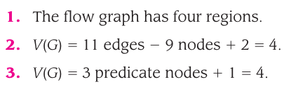
Cyclomatic Complexity
These slides are designed to accompany Software Engineering: A Practitioner’s Approach, 7/e (McGraw-Hill 2009). Slides copyright 2009 by Roger Pressman.

Slide 22
Cyclomatic Complexity
Note:
The value for V(G) provides you with an upper bound for the number of independent paths that form the basis set and, by implication, an upper bound on the number of tests that must be designed and executed to guarantee coverage of all program statements.
These slides are designed to accompany Software Engineering: A Practitioner’s Approach, 7/e (McGraw-Hill 2009). Slides copyright 2009 by Roger Pressman.

Slide 23
Cyclomatic Complexity
A number of industry studies have indicated
that the higher V(G), the higher the probability
or errors.
modules
V(G)
modules in this range are
more error prone
These slides are designed to accompany Software Engineering: A Practitioner’s Approach, 7/e (McGraw-Hill 2009). Slides copyright 2009 by Roger Pressman.

Slide 24
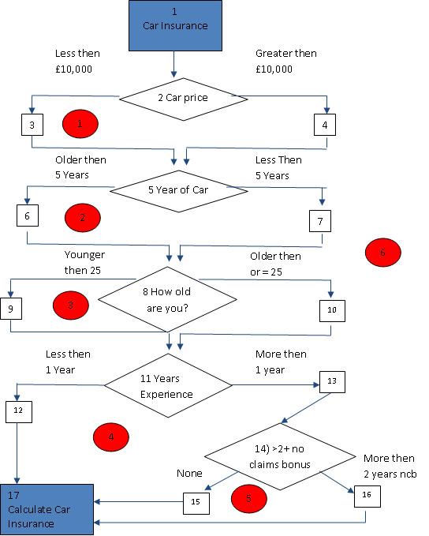
Line Coverage – Correctness Tests Cont.

Slide 25
Conclude McCabes Theory
The formulae:
V(G) = R
V (G) = E –N + 2
V(G) = P + 1
Our Example
V(G) = 6
V(G) = 21 -17 + 2 = 6
V(G) = 5 + 1 = 6
Resulting metrics calculations indicate that the maximum number of independent paths is 6.
Summary
Programs with cyclomatic complexities of less then 5 are simple and easy to understand
20+ The complexity is perceived as high.
50+ the software for practical purposes becomes unpractical.

Slide 26
Line Coverage – Correctness Tests Cont.
Complete Full Path Coverage
1= 1-2-3-5-6-8-9-11-12-17
2= 1-2-3-5-6-8-9-13-14-15-17
3= 1-2-3-5-6-8-9-11-13-14-16
4= 1-2-3-5-6-8-10-11-17
…
13= 1-2-4-5-6-8-9-11-12-17
14= 1-2-4-5-6-8-9-13-14-15-17
…
23= 1-2-4-5-7-8-10-11-13-14-15-17
24= 1-2-4-5-7-8-10-11-13-14-16-17

Slide 27
Deriving Test Cases
Summarizing:
  Using the design or code as a foundation, draw a corresponding flow graph.
  Determine the cyclomatic complexity of the resultant flow graph.
  Determine a basis set of linearly independent paths.
  Prepare test cases that will force execution of each path in the basis set.
These slides are designed to accompany Software Engineering: A Practitioner’s Approach, 7/e (McGraw-Hill 2009). Slides copyright 2009 by Roger Pressman.

Slide 28
Graph Matrices
A graph matrix is a square matrix whose size (i.e., number of rows and columns) is equal to the number of nodes on a flow graph
Each row and column corresponds to an identified node, and matrix entries correspond to connections (an edge) between nodes.
By adding a link weight to each matrix entry, the graph matrix can become a powerful tool for evaluating program control structure during testing
These slides are designed to accompany Software Engineering: A Practitioner’s Approach, 7/e (McGraw-Hill 2009). Slides copyright 2009 by Roger Pressman.

Slide 29
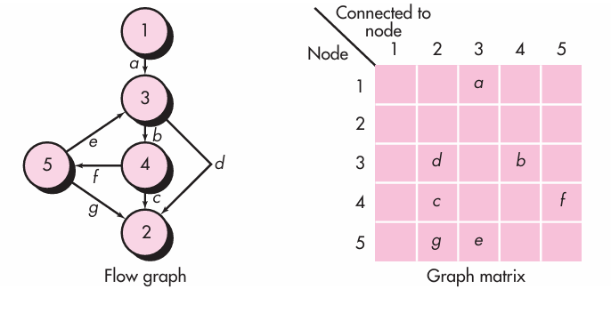
Graph Matrices
These slides are designed to accompany Software Engineering: A Practitioner’s Approach, 7/e (McGraw-Hill 2009). Slides copyright 2009 by Roger Pressman.

Slide 30
Graph Matrices
The graph matrix is nothing more than a tabular representation of a flow graph.
However, by adding a link weight to each matrix entry, the graph matrix can become a powerful tool for evaluating program control structure during testing.
The link weight provides additional information about control flow.
In its simplest form, the link weight is 1 (a connection exists) or 0 (a connection does not exist).
These slides are designed to accompany Software Engineering: A Practitioner’s Approach, 7/e (McGraw-Hill 2009). Slides copyright 2009 by Roger Pressman.

Slide 31
Graph Matrices
The link weights can be assigned other, more interesting properties:
  The probability that a link (edge) will be execute.
  The processing time expended during traversal of a link
  The memory required during traversal of a link
  The resources required during traversal of a link.
These slides are designed to accompany Software Engineering: A Practitioner’s Approach, 7/e (McGraw-Hill 2009). Slides copyright 2009 by Roger Pressman.

Slide 32
Control Structure Testing
Condition testing — a test case design method that exercises the logical conditions contained in a program module
Data flow testing — selects test paths of a program according to the locations of definitions and uses of variables in the program
These slides are designed to accompany Software Engineering: A Practitioner’s Approach, 7/e (McGraw-Hill 2009). Slides copyright 2009 by Roger Pressman.

Slide 33
Data Flow Testing
The data flow testing method [Fra93] selects test paths of a program according to the locations of definitions and uses of variables in the program.
  Assume that each statement in a program is assigned a unique statement number and that each function does not modify its parameters or global variables. For a statement with S as its statement number
    DEF(S) = {X | statement S contains a definition of X}
    USE(S) = {X | statement S contains a use of X}
  A definition-use (DU) chain of variable X is of the form [X, S, S'], where S and S' are statement numbers, X is in DEF(S) and USE(S'), and the definition of X in statement S is live at statement S'
These slides are designed to accompany Software Engineering: A Practitioner’s Approach, 7/e (McGraw-Hill 2009). Slides copyright 2009 by Roger Pressman.

Slide 34
Loop Testing
Simple
loop
Nested
Loops
Concatenated
Loops
Unstructured
These slides are designed to accompany Software Engineering: A Practitioner’s Approach, 7/e (McGraw-Hill 2009). Slides copyright 2009 by Roger Pressman.
Loops

Slide 35
Loop Testing: Simple Loops
The following set of tests can be applied to simple loops, where n is the maximum number of allowable passes through the loop.
1. skip the loop entirely
2. only one pass through the loop
3. two passes through the loop
4. m passes through the loop m < n
5. (n-1), n, and (n+1) passes through the loop
where n is the maximum number
of allowable passes
These slides are designed to accompany Software Engineering: A Practitioner’s Approach, 7/e (McGraw-Hill 2009). Slides copyright 2009 by Roger Pressman.

Slide 36
Loop Testing: Nested Loops
Nested Loops
Start at the innermost loop. Set all outer loops to their
minimum iteration parameter values.
Test the min+1, typical, max-1 and max for the
innermost loop, while holding the outer loops at their
minimum values.
Move out one loop and set it up as in step 2, holding all
other loops at typical values. Continue this step until
the outermost loop has been tested.
Concatenated Loops
If the loops are independent of one another
then treat each as a simple loop
else* treat as nested loops
endif*
for example, the final loop counter value of loop 1 is
used to initialize loop 2.
These slides are designed to accompany Software Engineering: A Practitioner’s Approach, 7/e (McGraw-Hill 2009). Slides copyright 2009 by Roger Pressman.

Slide 37
Black-Box Testing
(also called Behavioral Testing)
requirements
output
input
events
These slides are designed to accompany Software Engineering: A Practitioner’s Approach, 7/e (McGraw-Hill 2009). Slides copyright 2009 by Roger Pressman.

Slide 38
Black-Box Testing
Also called behavioral testing, focuses on the functional requirements of the software.
Black-box testing attempts to find errors in the following categories:
(1) incorrect or missing functions,
(2) interface errors,
(3) errors in data structures or external database access,
(4) behavior or performance errors, and
(5) initialization and termination errors.
These slides are designed to accompany Software Engineering: A Practitioner’s Approach, 7/e (McGraw-Hill 2009). Slides copyright 2009 by Roger Pressman.

Slide 39
Black-Box Testing
How is functional validity tested?
How is system behavior and performance tested?
What classes of input will make good test cases?
Is the system particularly sensitive to certain input values?
How are the boundaries of a data class isolated?
What data rates and data volume can the system tolerate?
What effect will specific combinations of data have on system operation?
These slides are designed to accompany Software Engineering: A Practitioner’s Approach, 7/e (McGraw-Hill 2009). Slides copyright 2009 by Roger Pressman.

Slide 40
Black-Box Testing Techniques
Graph Based Testing Methods
Equivalence Partitioning
Boundary Value Analysis
Comparison Testing
Orthogonal Array Testing
Model-Based Testing
These slides are designed to accompany Software Engineering: A Practitioner’s Approach, 7/e (McGraw-Hill 2009). Slides copyright 2009 by Roger Pressman.

Slide 41
Graph Based Testing Methods
The first step in black-box testing is to understand the objects that are modeled in software and the relationships that connect these objects.
Once this has been accomplished, the next step is to define a series of tests that verify “all objects have the expected relationship to one another”
software testing begins by creating a graph of important objects and their relationships and then devising a series of tests that will cover the graph so that each object and relationship is exercised and errors are uncovered.
These slides are designed to accompany Software Engineering: A Practitioner’s Approach, 7/e (McGraw-Hill 2009). Slides copyright 2009 by Roger Pressman.

Slide 42
Graph Based Testing Methods
To accomplish these steps, you begin by creating a graph—a collection of nodes that represent objects, links that represent the relationships between objects, node weights that describe the properties of a node (e.g., a specific data value or state behavior), and link weights that describe some characteristic of a link.
Nodes are represented as circles connected by links that take a number of different forms.
A directed link (represented by an arrow) indicates that a relationship moves in only one direction.
A bidirectional link, also called a symmetric link, implies that the relationship applies in both directions.
Parallel links are used when a number of different relationships are established between graph nodes.
These slides are designed to accompany Software Engineering: A Practitioner’s Approach, 7/e (McGraw-Hill 2009). Slides copyright 2009 by Roger Pressman.

Slide 43
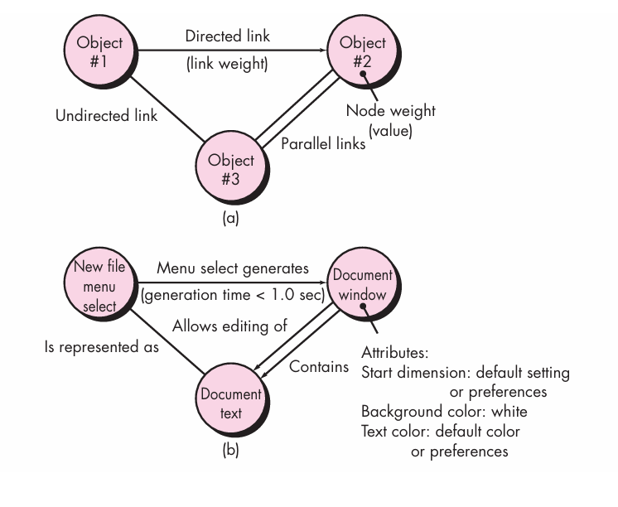
Graph-Based Methods
These slides are designed to accompany Software Engineering: A Practitioner’s Approach, 7/e (McGraw-Hill 2009). Slides copyright 2009 by Roger Pressman.

Slide 44
Equivalence Partitioning
Equivalence partitioning is a black-box testing method that divides the input domain of a program into classes of data from which test cases can be derived.
Test-case design for equivalence partitioning is based on an evaluation of equivalence classes for an input condition.
An equivalence class represents a set of valid or invalid states for input conditions.
These slides are designed to accompany Software Engineering: A Practitioner’s Approach, 7/e (McGraw-Hill 2009). Slides copyright 2009 by Roger Pressman.

Slide 45
Equivalence Partitioning
If a set of objects can be linked by relationships that are symmetric, transitive, and reflexive, an equivalence class is present.
Typically, an input condition is either a specific numeric value, a range of values, a set of related values, or a Boolean condition.
These slides are designed to accompany Software Engineering: A Practitioner’s Approach, 7/e (McGraw-Hill 2009). Slides copyright 2009 by Roger Pressman.

Slide 46
Equivalence Partitioning
Equivalence classes may be defined according to the following guidelines:
1. If an input condition specifies a range, one valid and two invalid equivalence classes are defined.
2. If an input condition requires a specific value, one valid and two invalid equivalence classes are defined.
3. If an input condition specifies a member of a set, one valid and one invalid equivalence class are defined.
4. If an input condition is Boolean, one valid and one invalid class are defined.
These slides are designed to accompany Software Engineering: A Practitioner’s Approach, 7/e (McGraw-Hill 2009). Slides copyright 2009 by Roger Pressman.

Slide 47
Equivalence Partitioning
If a program accepts the number of hours worked, you can partition the input into
"valid" (0-168),
"invalid" (<0 or >168), and
"boundary" (0, 168).
These slides are designed to accompany Software Engineering: A Practitioner’s Approach, 7/e (McGraw-Hill 2009). Slides copyright 2009 by Roger Pressman.

Slide 48
Equivalence Partitioning
Example: Validating User Age in a Registration Form
Requirement:
The application requires users to be between 18 and 59 years old to register.
Equivalence Partitions:
  Valid: 18 to 59 (inclusive)
  Invalid: Less than 18, Greater than 59
Test Cases:
  Valid: 18, 25, 59 (representative values within the valid range)
  Invalid: 17, 60 (values outside the valid range)
These slides are designed to accompany Software Engineering: A Practitioner’s Approach, 7/e (McGraw-Hill 2009). Slides copyright 2009 by Roger Pressman.

Slide 49
Equivalence Partitioning
Expected Behavior:
  For valid ages (18-59), the registration should proceed without errors.
  For invalid ages, the application should display an appropriate error message (e.g., "You must be between 18 and 59 years old to register").
These slides are designed to accompany Software Engineering: A Practitioner’s Approach, 7/e (McGraw-Hill 2009). Slides copyright 2009 by Roger Pressman.

Slide 50
Boundary Value Analysis
Boundary value analysis is the best known functional testing technique.
Boundary value analysis leads to a selection of test cases that exercise bounding values.
Boundary value analysis is a test-case design technique that complements equivalence partitioning.
Rather than selecting any element of an equivalence class, BVA leads to the selection of test cases at the “edges” of the equivalence classes.
These slides are designed to accompany Software Engineering: A Practitioner’s Approach, 7/e (McGraw-Hill 2009). Slides copyright 2009 by Roger Pressman.

Slide 51
Boundary Value Analysis
Boundary testing is the process of testing between extreme ends or boundaries between partitions of the input values.
So these extreme ends like Start- End, Lower- Upper, Maximum Minimum, Just Inside-Just Outside values are called boundary values and the testing is called "boundary testing“.
In Boundary Testing, Equivalence Class Partitioning has a main role.
Boundary Testing comes after the Equivalence Class Partitioning. Here we check the boundary values of ECP.

Slide 52
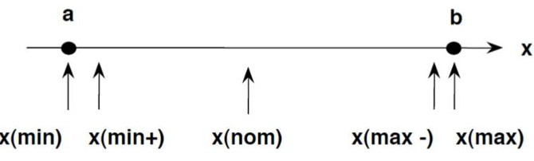
Boundary Value Analysis
The basic idea in boundary value analysis is to select input variable values at their:
  Minimum
  Just above the minimum
  A nominal value
  Just below the maximum
  Maximum

Slide 53
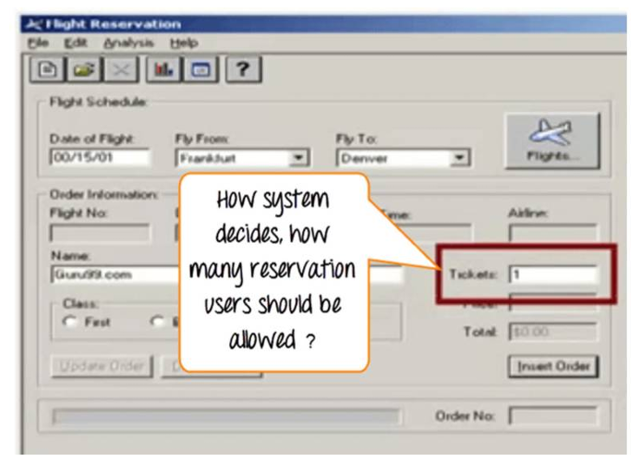
Boundary Value Analysis
Example:
Let's consider the behavvior of tickets in the Flight reservation application, while booking a new flight.

Slide 54
Boundary Value Analysis
Ticket values 1 to 10 are considered valid & ticket is booked. While value 11 to 99 are considered invalid for reservation and error message will appear, "Only ten tickets may be ordered at one time."

Slide 55
Boundary Value Analysis
Ticket values 1 to 10 are considered valid & ticket is booked. While value 11 to 99 are considered invalid for reservation and error message will appear, "Only ten tickets may be ordered at one time."
Any Number greater than 10 entered in the reservation column (let say 11) is considered invalid. •
Any Number less than 1 that is 0 or below, then it is considered invalid.
Numbers 1to 10areconsidered valid
Any 3 Digit Number say-100 is invalid.
We cannot test all the possible values because if done, the number of test cases will be more than 100. To address this problem, we use equivalence partitioning hypothesis where we divide the possible values of tickets into groups or sets as shown below where the system behavior can be considered the same

Slide 56
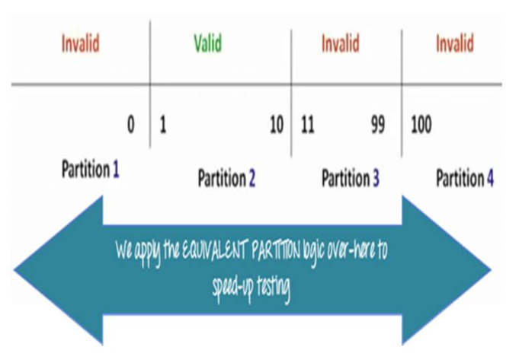
Boundary Value Analysis

Slide 57
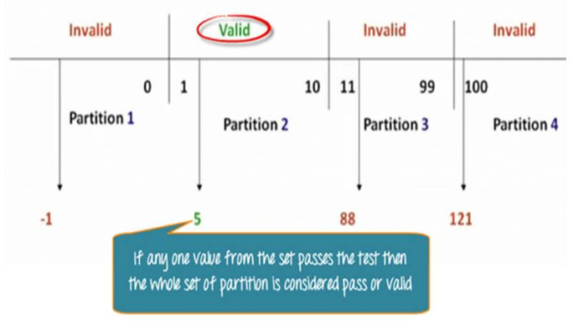
Boundary Value Analysis
The divided sets are called Equivalence Partitions or Equivalence Classes.
Then we pick only one value from each partition for testing.
The hypothesis behind this technique is that if one condition/value in a partition passes all others will also pass. Likewise, if one condition in a partition fails, all other conditions in that partition will fail.

Slide 58
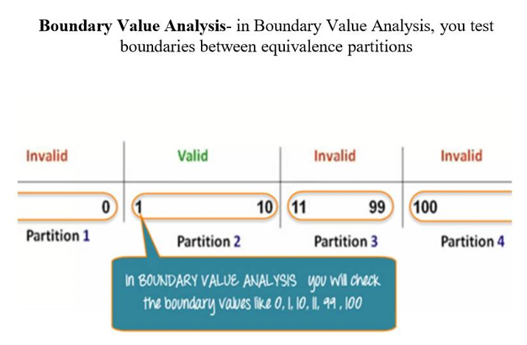
Boundary Value Analysis

Slide 59
Comparison Testing
Used only in situations in which the reliability of software is absolutely critical (e.g., human-rated systems)
  Separate software engineering teams develop independent versions of an application using the same specification
  Each version can be tested with the same test data to ensure that all provide identical output
  Then all versions are executed in parallel with real-time comparison of results to ensure consistency
These slides are designed to accompany Software Engineering: A Practitioner’s Approach, 7/e (McGraw-Hill 2009). Slides copyright 2009 by Roger Pressman.

Slide 60
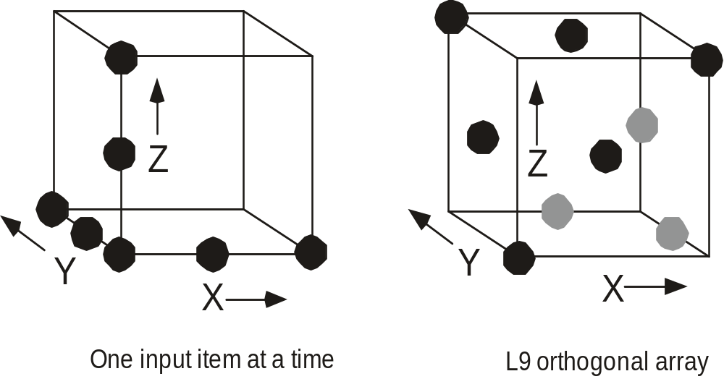
Orthogonal Array Testing
Used when the number of input parameters is small and the values that each of the parameters may take are clearly bounded
These slides are designed to accompany Software Engineering: A Practitioner’s Approach, 7/e (McGraw-Hill 2009). Slides copyright 2009 by Roger Pressman.

Slide 61
Model-Based Testing
Analyze an existing behavioral model (state transition diagram) for the software or create one.
  Recall that a behavioral model indicates how software will respond to external events or stimuli.
Traverse the behavioral model and specify the inputs that will force the software to make the transition from state to state.
  The inputs will trigger events that will cause the transition to occur.
Review the behavioral model and note the expected outputs as the software makes the transition from state to state.
Execute the test cases.
Compare actual and expected results and take corrective action as required.
These slides are designed to accompany Software Engineering: A Practitioner’s Approach, 7/e (McGraw-Hill 2009). Slides copyright 2009 by Roger Pressman.

